Slide 1
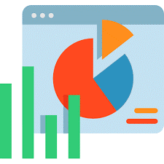


Data Analyst Bootcamp Final Project

Slide 2




Sine GÖKHAN
DATA HARMONY
TEAM
Arda KANTIK
İrfan MIZRAKCI
Yağız ESMERLİGİL

Slide 3

Project Name :
Harmony Yazılım ve Danışmanlık, Data Analizi ve
Çözümleri (Superstore Projesi)
Business Objective:
Find best-selling products
Creating customer segments and examining the difference in sales and profitability between them
Finding profit margin by product
Interpreting delivery times on a shipment basis and finding the more effective and economical one
Comparison of sales by months, seasons, cities and regions
Data Understanding/Summary:
Data set with 25 variables and 9995 rows
It generally contains orders and sub-details about orders (order date, customer information, quantity, unit price, product name, category information, etc.)
It may be necessary to examine the data set for null values and outliers. Additionally, it is a repetitive data set, not a singular one, based on order number
Target Analytical Solutions:
Insight Generation from CRM Analysis, Segmentation with RFM Analysis, Data Preparation Process (Handling Outliers and Missing Datas), Summary Tables and Graphs, Statistical Tests ,Time Series Analysis with Machine Learning

